Slide 1
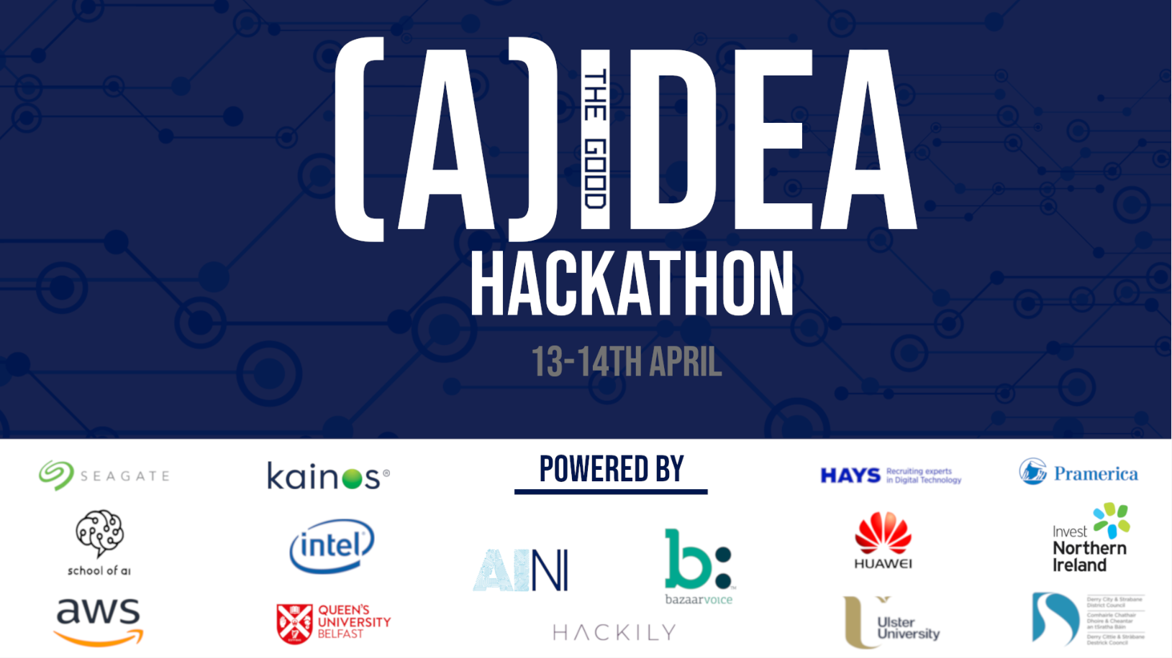
Notes:
PLACEHOLDER SLIDE

Slide 2



Welcome
Notes:
Welcome – Introductory Notes

Slide 3

Hackathon Vision
Apply the technology of AI towards scenarios that yeild a wider public good, particularly for Northern Ireland.
Provide a cohesive environment for learning to build AI capability with the NI technology eco-system, help the country become seen as a local hub for AI in the United Kingdom.
Build connections with other attendees, create compelling solutions & have fun.
Notes:
Objectives of the Hackathon – AI for Good / Learning

Slide 4



One Hackathon, Two Locations
200+ People
4 Workshops
‘Always On’ Live Stream
Notes:
Discuss Belfast / Derry – How we are connecting.
Thanks Peter Devine / Thanks Russell Kane

Slide 5


Slide 6

Agenda
ACTIVITY | ESTIMATED TIME SLOT
Welcome / Kick off | 10.30
Hackathon Begins | 11.30
Workshop: Intro to Data Science | 12.15
Lunch – First Floor Breakout Area | 13.30
Workshop 2: XP Innovates | 15.30
Workshop 3: CV Clinic | 16.15
Restart – Day 2 | 10.30
Judging Begins | 12.30
Awards | 14.30
Notes:
Agenda

Slide 7

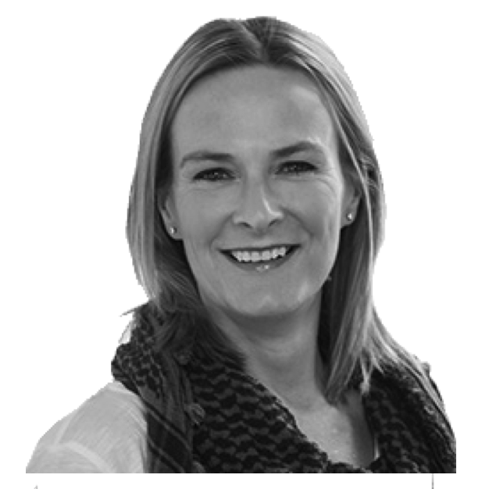


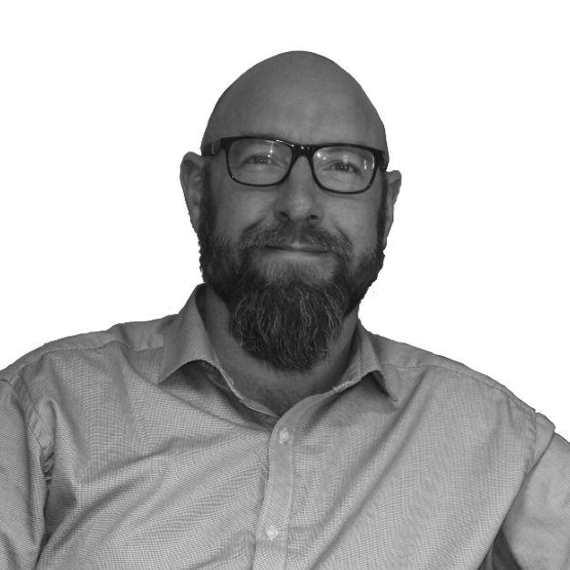
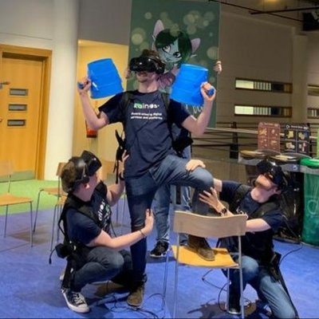

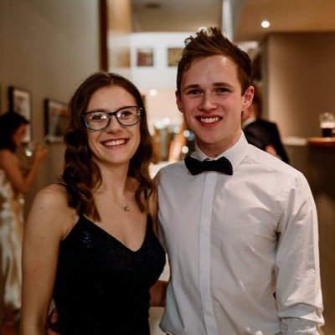


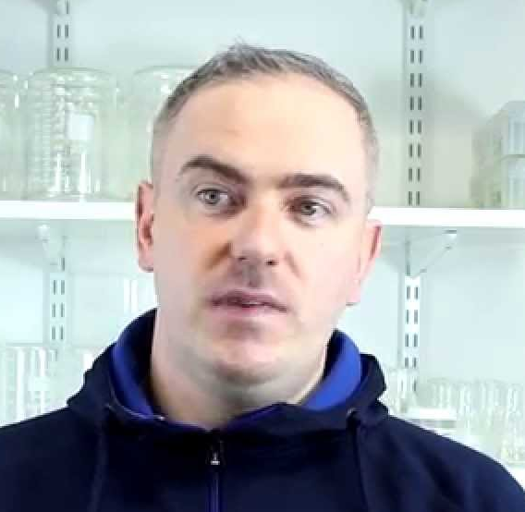
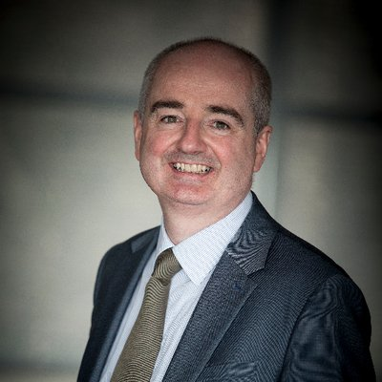

The AI:NI Team
Gillian Colan O’Leary
Austin Tanney
Jake Young
Chloe Thompson
Gary Doherty
Peter Devine
Notes:
Thank The Team – Point Out the Mentors on your location.

Slide 8
Notes:
Thank Sponsors – Point out Bazaar Voice as the diamond sponsor.

Slide 9




Important Resources
Notes:
Mention slack – GitHub resources – Wifi

Slide 10

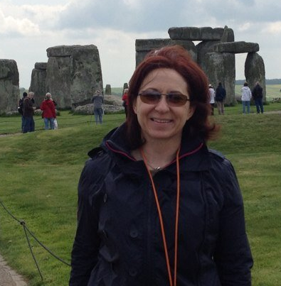

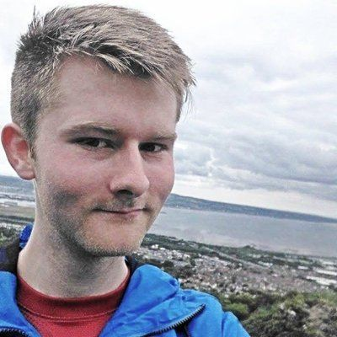
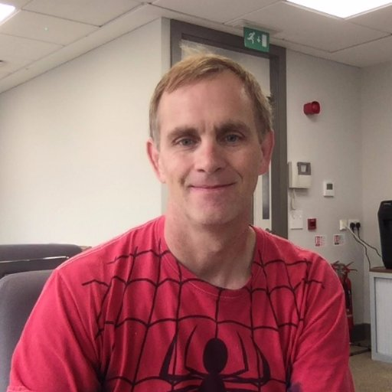
Hackathon Judges
Paul Hill
Tracey Walsh
Derek Collins
Austin / Jordan
Notes:
Judges – Point them out + Loose mention of experiences

Slide 11

Hackathon Challenges / Data
CHALLENGE 1: BAZAAR VOICE
For our challenge, we’ll provide two datasets. One dataset of fake reviews, that have been produced by a model, and then a dataset of real reviews. Your task is to develop a model that can classify a review as fake or authentic.
CHALLENGE 2: PELTARIAN
….
CHALLENGE 3: INTEL
….
*For more detail, refer to the detailed descriptions on GitHub.
Notes:
Judges – Point them out + Loose mention of experiences

Slide 12
Open Source Data
Police.co.uk
NINAS NISRA
Police.co.uk
Derry Council
Open Data NI
OSNI Spatial
Met Office
Kaggle
Air Quality NI
Belfast City Council
*For more detail, refer to the list on GitHub – With even more options!
Notes:
Judges – Point them out + Loose mention of experiences

Slide 13

Prizes
FIRST PRIZE SECOND PRIZE THIRD PRIZE SPOT PRIZES
Nintendo Switch x 2
Bose Headphones
3D Printer
Oculus Headset
Amazon Vouchers
£XXX
£XXX
£XXX
Notes:
Judges – Point them out + Loose mention of experiences

Slide 14

Team Formation
If you don’t have a team yet, or want to seek out a new team member with a specefic set of skills – no fear, we have you covered.
Jake Young, alongside our wider mentors will help match you with a team.
Side note: We encourage you all to use the mentors knowledge and work together if possible – its not all about winning ;)
Notes:
Judges – Point them out + Loose mention of experiences

Slide 15
Diamond Sponsor Keynote
Notes:
Welcome – Introductory Notes

Slide 16
Agenda
ACTIVITY | ESTIMATED TIME SLOT
Welcome / Kick off | 10.30
Hackathon Begins | 11.30
Workshop: Intro to Data Science | 12.15
Lunch – First Floor Breakout Area | 13.30
Workshop 2: XP Innovates | 15.30
Workshop 3: CV Clinic | 16.15
Restart – Day 2 | 10.30
Judging Begins | 12.30
Awards | 14.30
Notes:
Point out Agenda Again
Anyone who needs team assistance, or experienced any early issues
This entire floor is yours to use, yours to explore, yours to create – look forward to

Slide 17
Notes:
Away you go

